Slide 1
Fraud Detection on Bank Payments
Created by:
Kunal Kashyap
Avinash gautam
Bandaru Geetha Sabari

Slide 2
Fraud and detecting it
Fraudulent activity can be observed in a variety of industries, including e-commerce, healthcare, payment systems, and banking. Fraud is a multibillion dollar industry that keeps growing. According to the PwC global economic crime report from 2018 [1], of the 7,200 organisations surveyed, half (49 percent) have encountered fraud of some type.
Fraud detection is possible even if it may seem frightening to organisations, thanks to intelligent solutions like rules engines and machine learning. The majority of individuals on Kaggle are familiar with machine learning, but this is some quick background on rule engines.
A rules engine is a piece of software that carries out one or more business rules in a real-world runtime setting. For the purpose of conveying problem-specific knowledge to the rules engine and ultimately to production, these rules are typically created by domain experts. Limiting the amount of transactions per period (velocity rules) and disallowing transactions from previously identified fraudulent IP addresses and/or domains are two rules examples for fraud detection.
Rules are excellent at spotting various types of fraud, but because they have predefined threshold values, they may produce a large number of false positives or false negatives. Consider a rule that prevents a transaction with a value greater than $10,000 from being processed for a certain user. If this user has a history of fraud, he or she may be aware that the system has a threshold and can simply conduct a transaction that is slightly below the threshold value (9999 dollars).
ML can assist with these issues and lower the chance of fraud and the possibility that a firm will lose money. Fraud detection would be more accurate and confident with the use of rules and machine learning..

Slide 3
Banksim dataset
We use the Banksim dataset to identify fraudulent transactions. This artificially created dataset consists of payments from different consumers made over various time frames and in varying quantities. Check out the [Kaggle page](https://www.kaggle.com/ntnu-testimon/banksim1) for this dataset, which also includes a link to the original paper, for more details on the dataset.
Here what we'll do in this kernel:
1. [Exploratory Data Analysis (EDA) ](# Explaratory-Data-Analysis)
2. [Data Preprocessing](#Data-Preprocessing)
3. [Oversampling with SMOTE](#Oversampling-with-SMOTE)
4. [K-Neighbours Classifier](#K-Neighbours-Classifier)
5. [Random Forest Classifier](#Random-Forest-Classifier)
6. [ XGBoost Classifier] (# XGBoost-Classifier)
7. [Conclusion](#Conclusion)

Slide 4
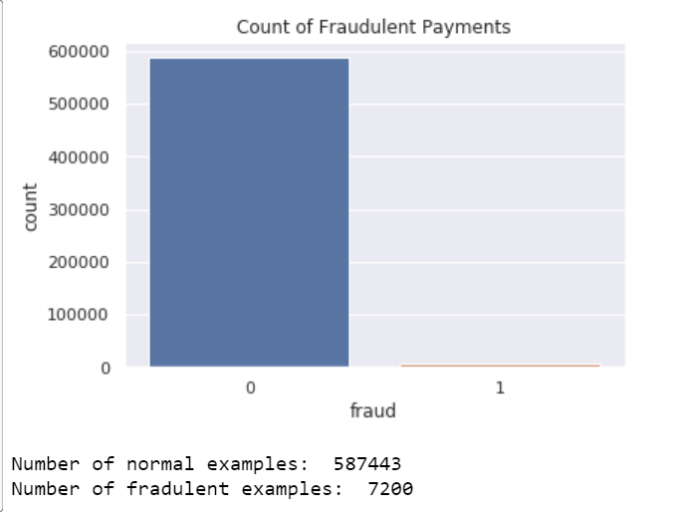
two data frames with fraud and non-fraud data

Slide 5
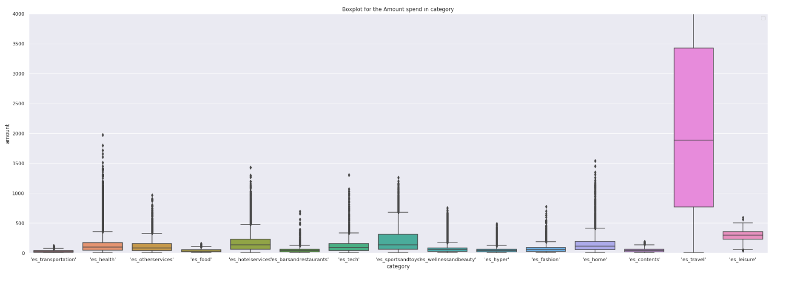
Plot histograms of the amounts in fraud and non-fraud data

Slide 6
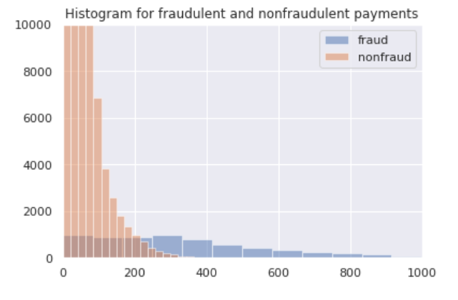
Plot histograms of the amounts in fraud and non-fraud data

Slide 7
Conclusion
We attempted to perform fraud detection on bank payment data in this kernel, and our classifiers produced outstanding results. We used the SMOTE oversampling technique to create additional minority class cases since fraud datasets have an imbalance class problem.
I appreciate you taking the time to read or simply examine the outcomes of my first kernel; I hope you found it interesting. I would appreciate any feedback, suggestions, or comments, and I hope you have a wonderful day filled with plenty of lovely information.

Slide 8
Thank you

